Slide 1




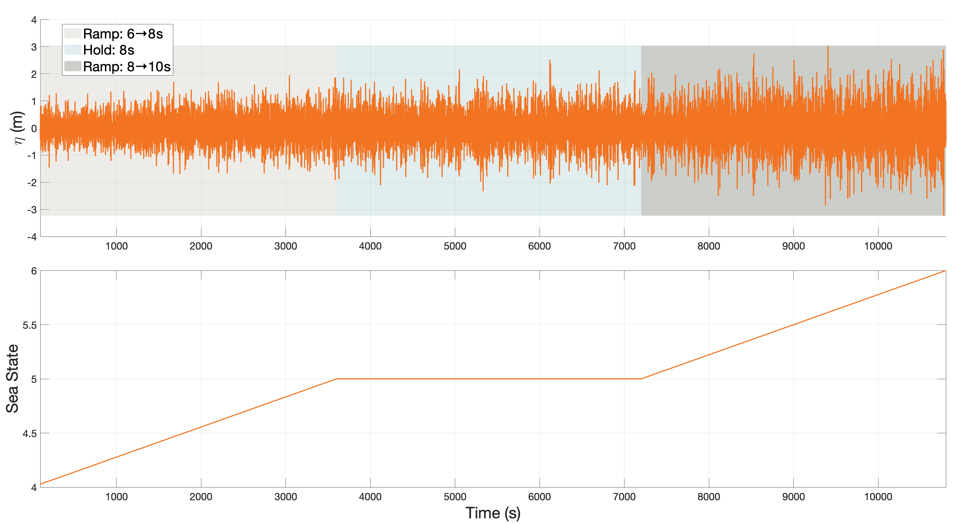

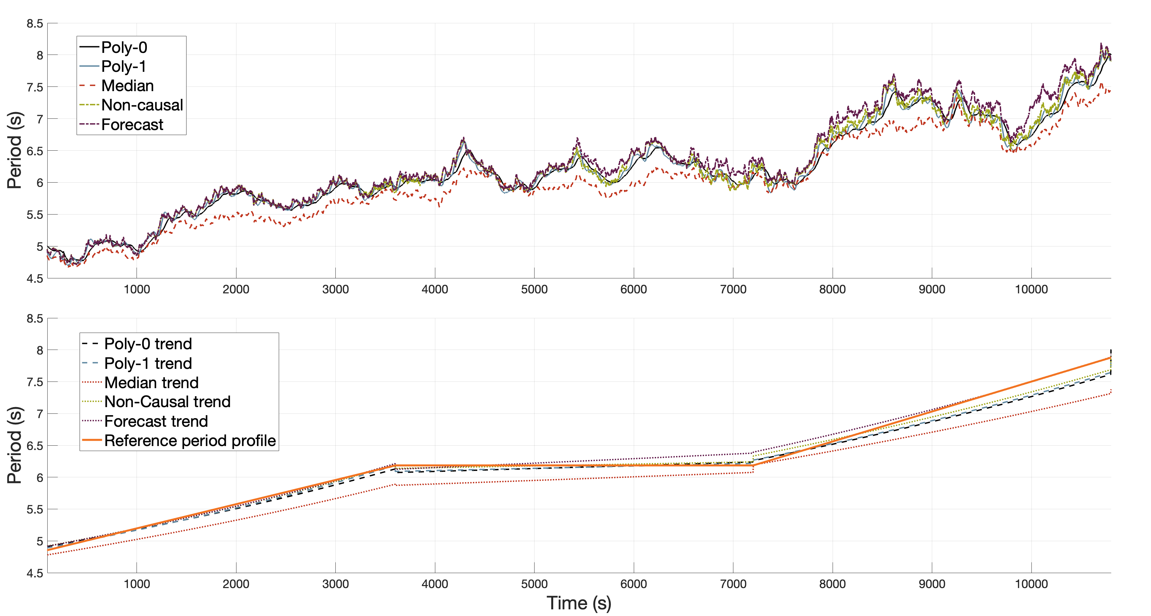




Real-Time Tracking of Instantaneous Frequency during Sea State Changes Inyong Kim, Prof. Ted Brekken, Prof. Solomon Yim, Prof. Yue Cao /Oregon State University, Corvallis, OR Prof. Brian Johnson, , Pranav Chandran /University of Texas, Austin, TX
The forecasted short‐time Hilbert‐transform method delivers the most accurate real-time tracking of changing wave periods—matching the non-causal benchmark with minimal lag and error—enabling adaptive WEC control to respond instantaneously to dynamic sea states and maximize energy capture.
1.Introduction
RESULTS
Ocean wave energy is distributed across a range of frequencies that evolve over time, especially during transitions between sea states. Accurately tracking the frequency content of waves in real time is essential for understanding wave dynamics and for potential use in forecasting, control, and system design.
While frequency-domain spectra (e.g., Pierson-Moskowitz) provide time-averaged insight, they lack the temporal resolution required to capture short-term fluctuations or transient events. Instantaneous frequency (IF), derived from the phase of the analytic signal, offers a promising alternative — enabling time-localized characterization of wave energy content.
However, real-time IF estimation presents key challenges:
The Hilbert transform is inherently non-causal.
Using only past data introduces endpoint artifacts.
Noise and multiple peaks per wave cycle can degrade frequency tracking performance.
To address these issues, this work investigates four real-time IF estimation strategies based on the Short-Time Hilbert Transform (ST-HT), augmented with filtering and forecasting techniques, and evaluates their accuracy under dynamically changing sea conditions.
Table 1. Sea‐State Transition Phases and Wave Conditions
Phase | Time Interval (s) | Start Condition | End Condition
Ramp 1 | 0–3600 | Sea State 4 (Moderate; Hs = 1.44 m, Tp = 6 s) | Sea State 5 (Rough; Hs = 2.6 m, Tp = 8 s)
Hold | 3600–7200 | Sea State 5 (Rough; Hs = 2.6 m, Tp = 8 s) | Sea State 5 (Rough; Hs = 2.6 m, Tp = 8 s)
Ramp 2 | 7200–10800 | Sea State 5 (Rough; Hs = 2.6 m, Tp = 8 s) | Sea State 6 (Very Rough; Hs = 4 m, Tp = 10 s)
2.Methodology
Figure 1 (top). Surface elevation η(t) (orange) over three 1 h segments, with translucent bands marking the 6→8 s ramp, 8 s hold, and 8→10 s ramp.
(bottom). Douglas Sea‐scale index time series showing the transition from state 4 to 5, plateau, and then to state 6 over the same intervals.
This study evaluates four real-time strategies to estimate the instantaneous frequency (IF) of ocean waves during sea state changes. Methods use the Short-Time Hilbert Transform (ST-HT) applied to a trailing time window of the surface elevation signal.
• ST-HT computes the analytic signal, and the IF is derived by differentiating its phase. Only past data is used for real-time compatibility.
• Two post-processing techniques are used to stabilize the IF output:
Median Filtering, which removes outliers and sharp noise spikes.
Polynomial Fitting, which smooths the IF trend using either a 0th-order (constant) or 1st-order (linear) fit.
• In addition, a “forecasted” version of the ST-HT method is evaluated by incorporating known future wave values into the analysis window. This simulates a centered (non-causal) window to assess the potential performance gain when future information is available. It offers a preview of wave-by-wave prediction capabilities using tools such as AI-trained wave models and buoy-based wave forecasts.
• The four methods are:
M1 – ST-HT + Median Filter.
M2 – ST-HT + Polynomial Fit (0th / 1st order).
M3 – ST-HT with inserted future values.
M4 – Full non-causal Hilbert transform
Table 2. Estimator Performance Metrics
Method | Bias (s) | RMSE (s)
Poly0 | –0.066 | 0.256
Poly1 | –0.053 | 0.267
Median | –1.047 | 1.101
Full HT | –0.017 | 0.266
Forecast | 0.036 | 0.275
Figure 2. (top) Moving‐mean period estimates by five methods (bottom) their segment‐wise linear fits with the intended mean‐period trajectory overlaid.
3. Test Scenario and Wave Conditions
Discussion
Future works
To benchmark our real-time frequency trackers, we synthesize a controlled Pierson–Moskowitz sea-state transition using Douglas Sea Scale categories as shown in Figure 1 (top) and (bottom) :
• Ramp 1 (0–3600 s): from Sea State 4 (Moderate; Hs = 1.44 m, Tp = 6 s) to Sea State 5 (Rough; Hs = 2.6 m, Tp = 8 s)
• Hold (3600–7200 s): maintain Sea State 5 (Hs = 2.6 m, Tp = 8 s)
• Ramp 2 (7200–10800 s): from Sea State 5 to Sea State 6 (Very Rough; Hs = 4 m, Tp = 10 s)
Spectrally, each ramp shifts the energy peak toward lower frequencies (longer periods).
We generate η(t) via randomized-phase synthesis with 100 Monte Carlo runs performed to ensure statistical reliability.. This nonstationary, overlapping-component input poses a stringent challenge for short-window, causal frequency-tracking methods.
Figure 2 shows:
(top) Moving‐average instantaneous period estimates for each method.
(bottom) Their piecewise linear regressions overlaid on the PSD‐based mean‐period profile.
The fully non‐causal Hilbert transform tracks the true trend most accurately.
The forecasted ST-HT is the next best, closely following the non‐causal result.
Zero- and first-order polynomial fits perform moderately, with only small lag and bias.
The median‐filtered method shows the largest errors—its double filtering introduces extra distortion and prevents it from following the true profile.
Since the forecasted ST-HT delivered the best real-time tracking, we will next explore AI-driven or buoy-based pre-processing algorithms to predict the upcoming wave cycle. In parallel, we will use WEC-Sim to simulate wave energy–harvest efficiency under dynamic sea-state transitions by feeding our real-time dominant-period estimates into the WEC control model.
CONTACT
Inyong Kim
Oregon State University
Kiminy@Oregonstate.edu

